Slide 1




THE SCIENCE OF STORYTELLING
www.story-more.com

Slide 2




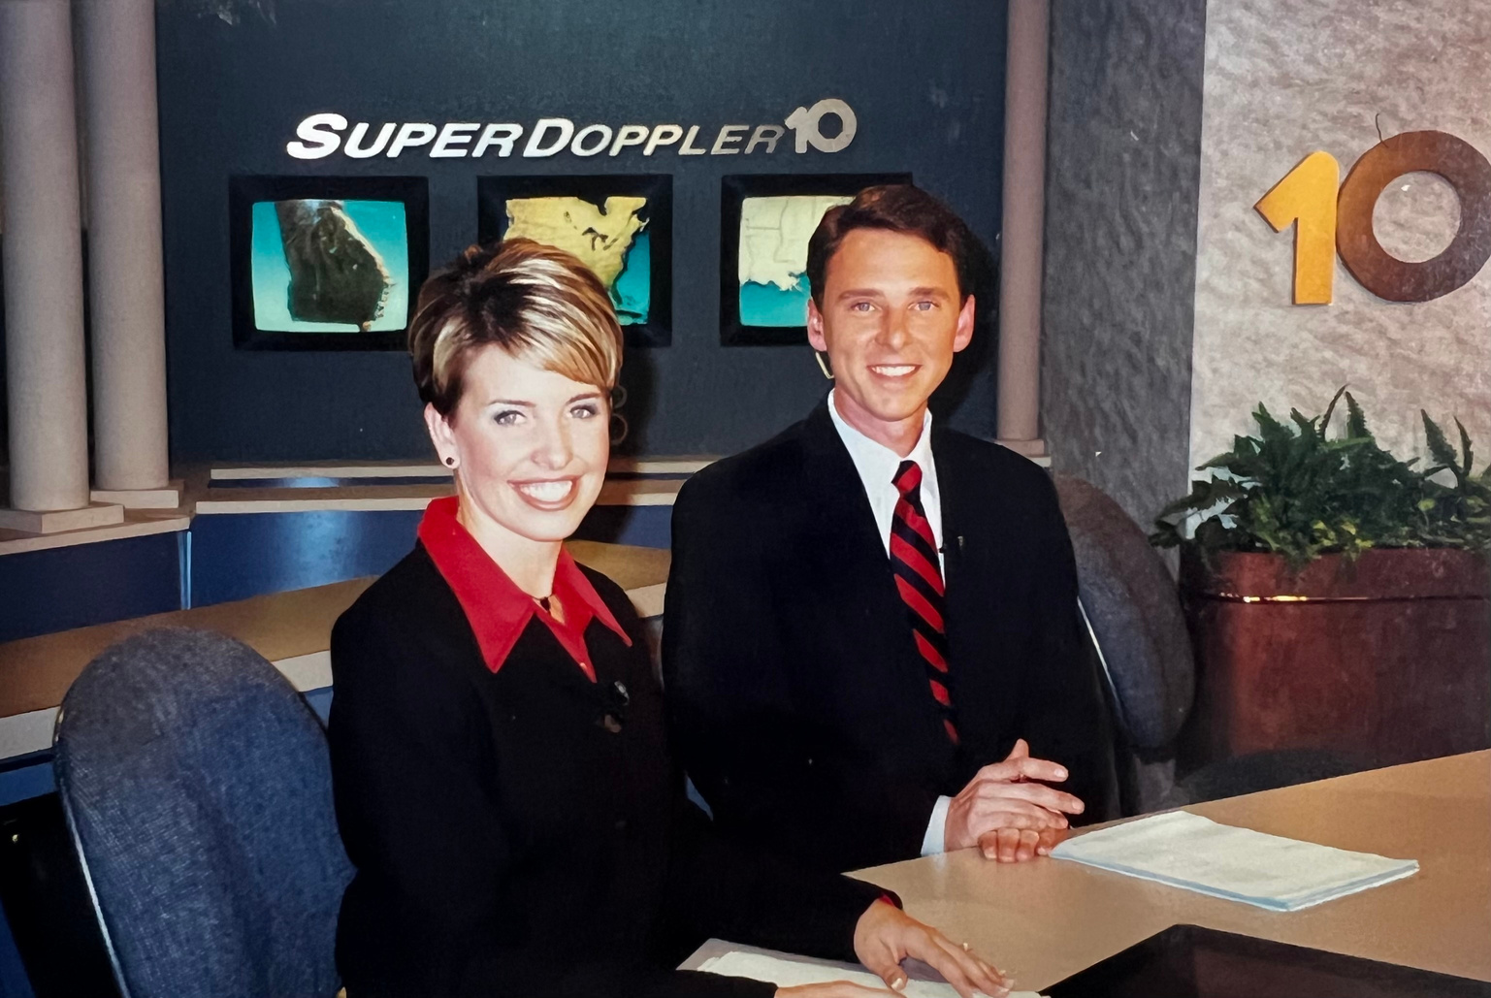


LIPSTICK LESSON

Slide 3



THE SCIENCE OF STORYTELLING
Storytelling Experiment
Story Data
Identify Your Story
Story Observation
Craft Your Story

Slide 4




TELL
YOUR
STORY
Pick a Memorable Moment

Slide 5


STORYTELLING ELEMENTS
INTRIGUE
AUTHENTICITY
EMOTION
VULNERABILITY
DETAILS

Slide 6

STORY DATA
  NEUROLOGICAL ENGAGEMENT
  DOPAMINE RELEASE
  MIRROR NEURONS
  COGNITIVE PROCESSING
60%
The brain processes images faster than words

Slide 7
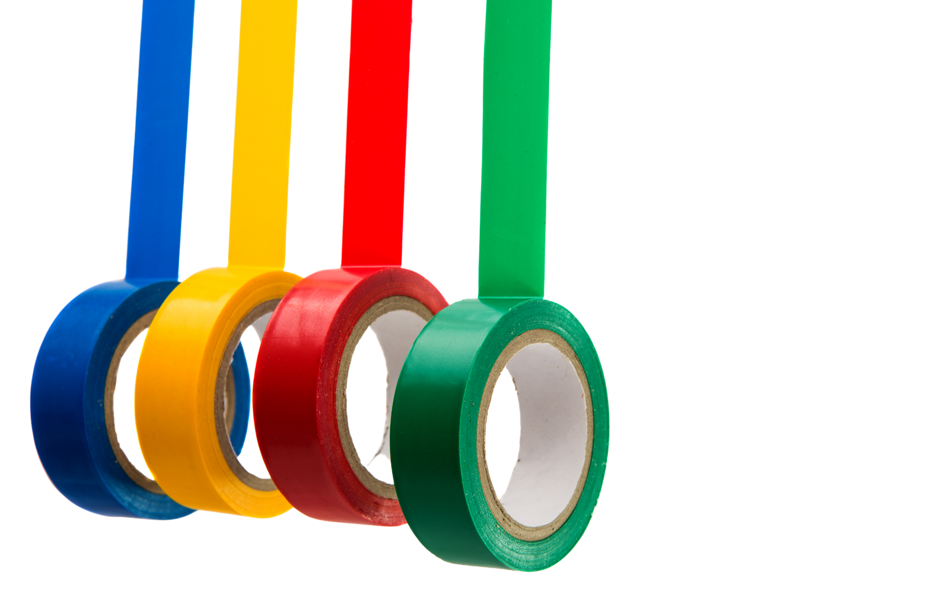


STICKY
FACTOR
EMOTION
BE REAL
INTRIGUE
Aim for the heart.
We remember stories that we feel.
Show vulnerability.
Be genuine & connect on a deeper level.
Leave them wanting more.

Slide 8



IDENTIFY YOUR STORY
      WHO
  WHERE
  WHAT
  WHY
  WHEN
  HOW

Slide 9




STORY ELEMENTS
CHARACTER
PROBLEM
SOLUTION
The voice of your story.
A person, place or thing
that drives the plot forward.
What problem are you trying to solve for your customer/client?
How does your product/service help solve the problem?
***Bonus Points: Hook & Call For Action

Slide 10

YOU ARE ONE OF A KIND

Slide 11

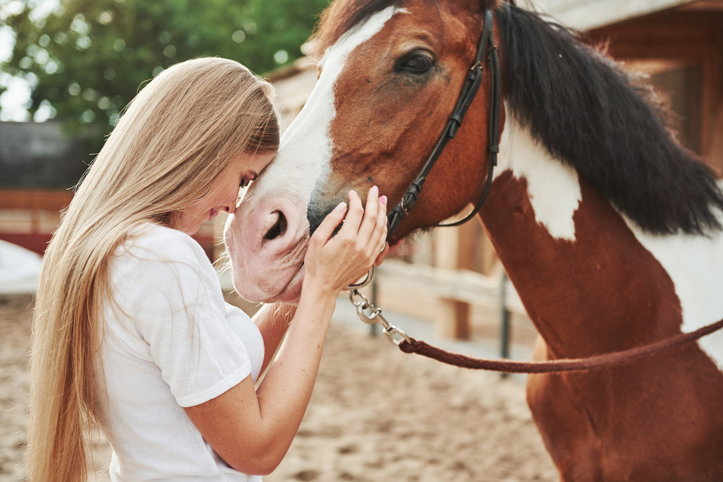
OBSERVATION
SHEPHERD YOUTH RANCH
Provides mental health services to emotionally wounded adults and children with equine assisted therapy.

Slide 12
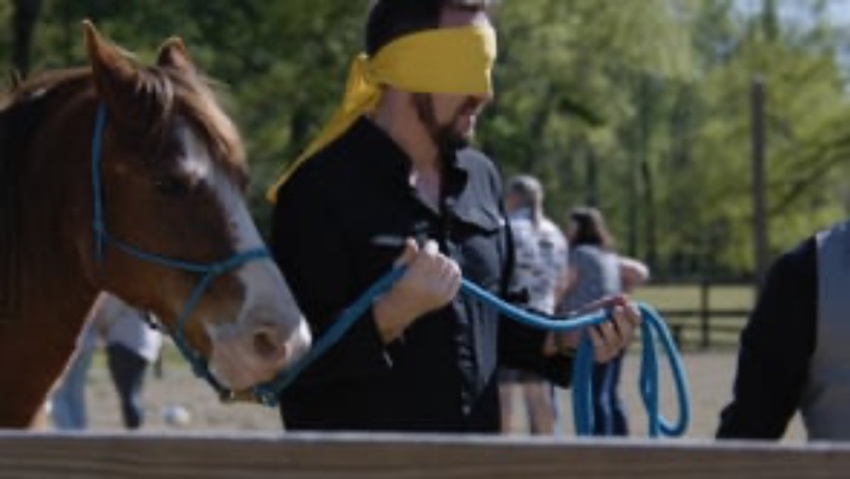

Slide 13

BUILD YOUR
STORY
KEEP IT SIMPLE
AIM FOR THE HEART
POWERFUL VISUALS
Pick one clear message and focus on nothing else.
Your audience connects with emotion.
Capture the attention of your audience

Slide 14
BUILD YOUR
STORY
LET THE CHARACTER LEAD
BEGINNING, MIDDLE AND END
MAKE IT MEMORABLE
Go deep with one story
Hook, Obstacle and Resolution
Attract the people you’re looking to attract.

Slide 15







LET'S TALK
SLOANE HEFFERNAN
@storymoremarketing
Sloane@story-more.com
www.story-more.com
919-609-4473

Slide 16





Storymore Brand Story Map

